Slide 1
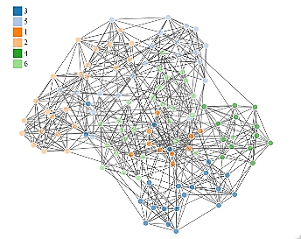
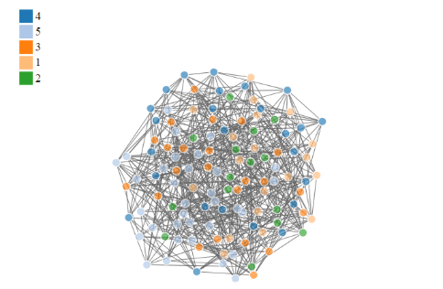
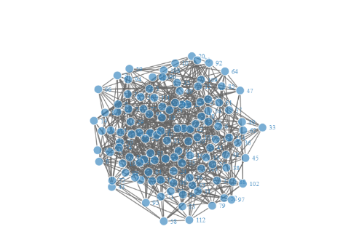
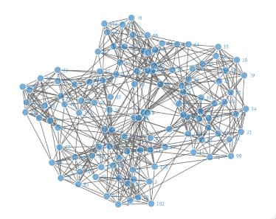



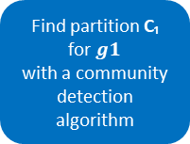
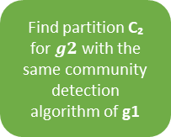
Real network $g1$
Find partition C₁ for $g1$
with a community detection algorithm
Find partition C₂ for $g2$ with the same community detection algorithm of g1
prepGraph()
Null network $g2$
random()
Perturb $g1$and $g2$by 𝒑
robinRobust()
Find partition $C_{1(p)}$ for ${g1}_{p}$and $C_{2(p)}$ for ${g2}_{p}$
𝒑 ∈ [0,0.6]
Compute a stability measure: Measure($C_{1(p)}$, $C_{1}$), Measure($C_{2(p)}$, $C_{2}$)
plotRobinRobust()
Create curves
robinAUC()
Compare two curves
robinFDATest()
robinGPTest()

Slide 2
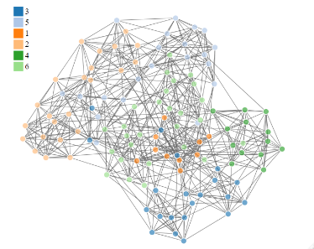
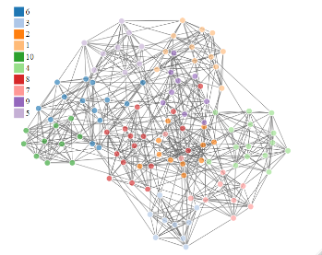

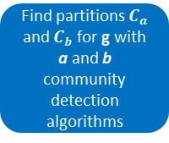

prepGraph()
Find partitions $C_{a}$ and $C_{b}$ for g with a and b community detection algorithms
Network $g$
Perturb $g$by 𝒑
robinCompare()
Find partition $C_{a(p)}$ and $C_{b(p)}$ for $g_{p}$
𝒑 ∈ [0,0.6]
Compute a stability measure: Measure($C_{a(p)}$, $C_{a}$), Measure($C_{b(p)}$, $C_{b}$)
plotRobinCompare()
Create curves
robinAUC()
Compare curves
robinFDATest()
robinGPTest()

